Slide 1
DETAILED PROJECT REPORT:
Stores Sales Prediction
Method:-Machine Learning Technology
Domain:-Sales & Marketing
Siddhartha Borgohain

Slide 2
Objective:-Objective: Nowadays, shopping malls and Big Marts keep track of individual item sales data in order to forecast future client demand and adjust inventory management. Our main objective is to Develop a model for predict the sales of the different stores of Big Mart. Benefits: Gives better insight of customers interest for the item. Find the store sales Easy to predict the sales information based on user data.

Slide 3
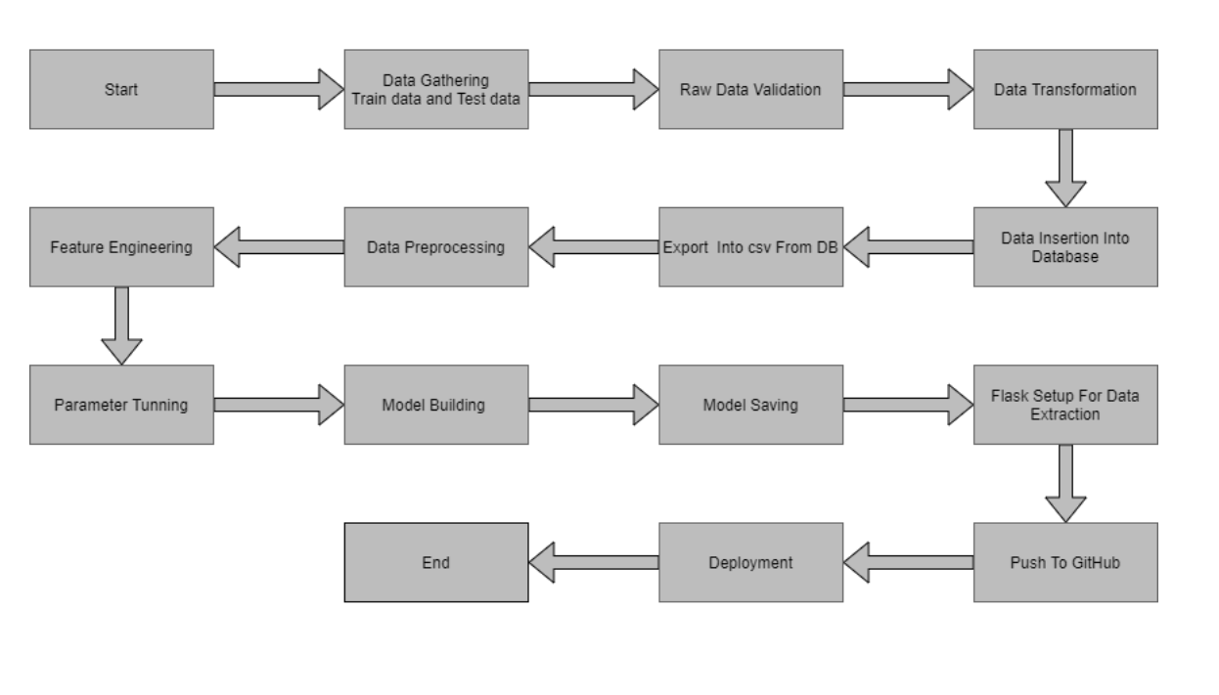
Architecture

Slide 4
DATASET:
We have train (8523) and test (5681) data set, train data set has both input and output variable(s). We need to predict the sales for test data set.
Data validation and Data transformation:
Item_Identifier: Unique product ID
Item_Weight: Weight of product
Item_Fat_Content: Whether the product is low fat or not
Item_Visibility: The % of total display area of all products in a store allocated to the particular product
Item_Type: The category to which the product belongs
Item_MRP: Maximum Retail Price (list price) of the product
Outlet_Identifier: Unique store ID
Outlet_Establishment_Year: The year in which store was established
PTO

Slide 5
Data validation and Data transformation:
Outlet_Size: The size of the store in terms of ground area covered
Outlet_Location_Type: The type of city in which the store is located
Outlet_Type: Whether the outlet is just a grocery store or some sort of supermarket
Item_Outlet_Sales: Sales of the product in the particulat store. This is the outcome
variable to be predicted.

Slide 6
Data Preprocessing:
Importing the data from source link https://www.kaggle.com/datasets/brijbhushannanda1979/bigmart-sales-data
Calculating the size of data
Finding the data types and null values
Finding the data distribution
Finding correlations between the features

Slide 7
DATA CLEANING AND EDA:
Finding the null values and cleaning the DATA by imputing the measures of central tendency
Using box plot outliers are detected and treated
We have counted every identity values in every categorical values
we have checked the item outlet sales in different time zones.

Slide 8
Feature ENGINEERING:
We have modified the item fat content feature into two distinct categories
We have removed all values have MRP less then zero.

Slide 9
MODEL PREPROCESSING:
Using label encoder we have converted the values into numerical .
We have split the data into train and test sets
We use RANDOMIZED GRID SEARCH CV technique for hyper parameter tuning
We have used Random Forest Regressor as our primary model
We have predicted the model with 60% accuracy score

Slide 10
MODEL Deployment:
Using pickle we have dumped the file in .pkl format
Using Flask and HTML we have created the web framework
We have stored the whole project file in github repo.
Model is deployed in heroku platform

